Slide 1
COMPARING THE UNITED STATES AND THE UNITED ARAB EMIRATES FOUNDING LEADERS AND DOCUMENTS
Lindsay Bowman
Harrisburg Academy

Slide 2
OBJECTIVES
Part I:
Students will review the founding of the United States and then examine the founding of another country – the United Arab Emirates.
Materials:
Writing instrument
Laptop
KWL Chart
K – What do I know?
W – What do I want to find out?
L – What did I learn?
Part II:
Students will compare and contrast key provisions in the U.S. Constitution with those in the constitution of the United Arab Emirates
Analyze how the constitution of the UAE affects everyday life and rights.
Consider whether the U.S. Constitution should be amended to include certain provisions found in the constitution of the UAE

Slide 3
FOUNDING OF THE UNITED STATES
Review and discuss what we know from Unit 2:
The Road to Revolution
Tighter British Control
Colonial Resistance
Declaring Independence
The American Revolution
The War and its Legacy
Confederation to Constitution
Articles of Confederation
Constitutional Convention
Independence Hall
Picture from Miss Bowman’s visit in 2014

Slide 4
FOUNDING OF THE UNITED ARAB EMIRATES
Divide students into groups to research the founding of the United Arab Emirates.
Using their laptops, direct them to the websites for the UAE Government and the UAE Embassy in Washington, D.C. (https://government.ae/en/about-the-uae/founders-of-the-union and http://www.uae-embassy.org/about-uae/history)
Who had control of this region before the unification of the Emirates?
Why did they seek their independence?
Who are the “Founding Fathers?”
When was their independence finalized?
Etihad Museum, 2017

Slide 5
PICTURES FROM MISS BOWMAN’S TRIP, MARCH 2017
Union House: Dar El-Etihad

Slide 6
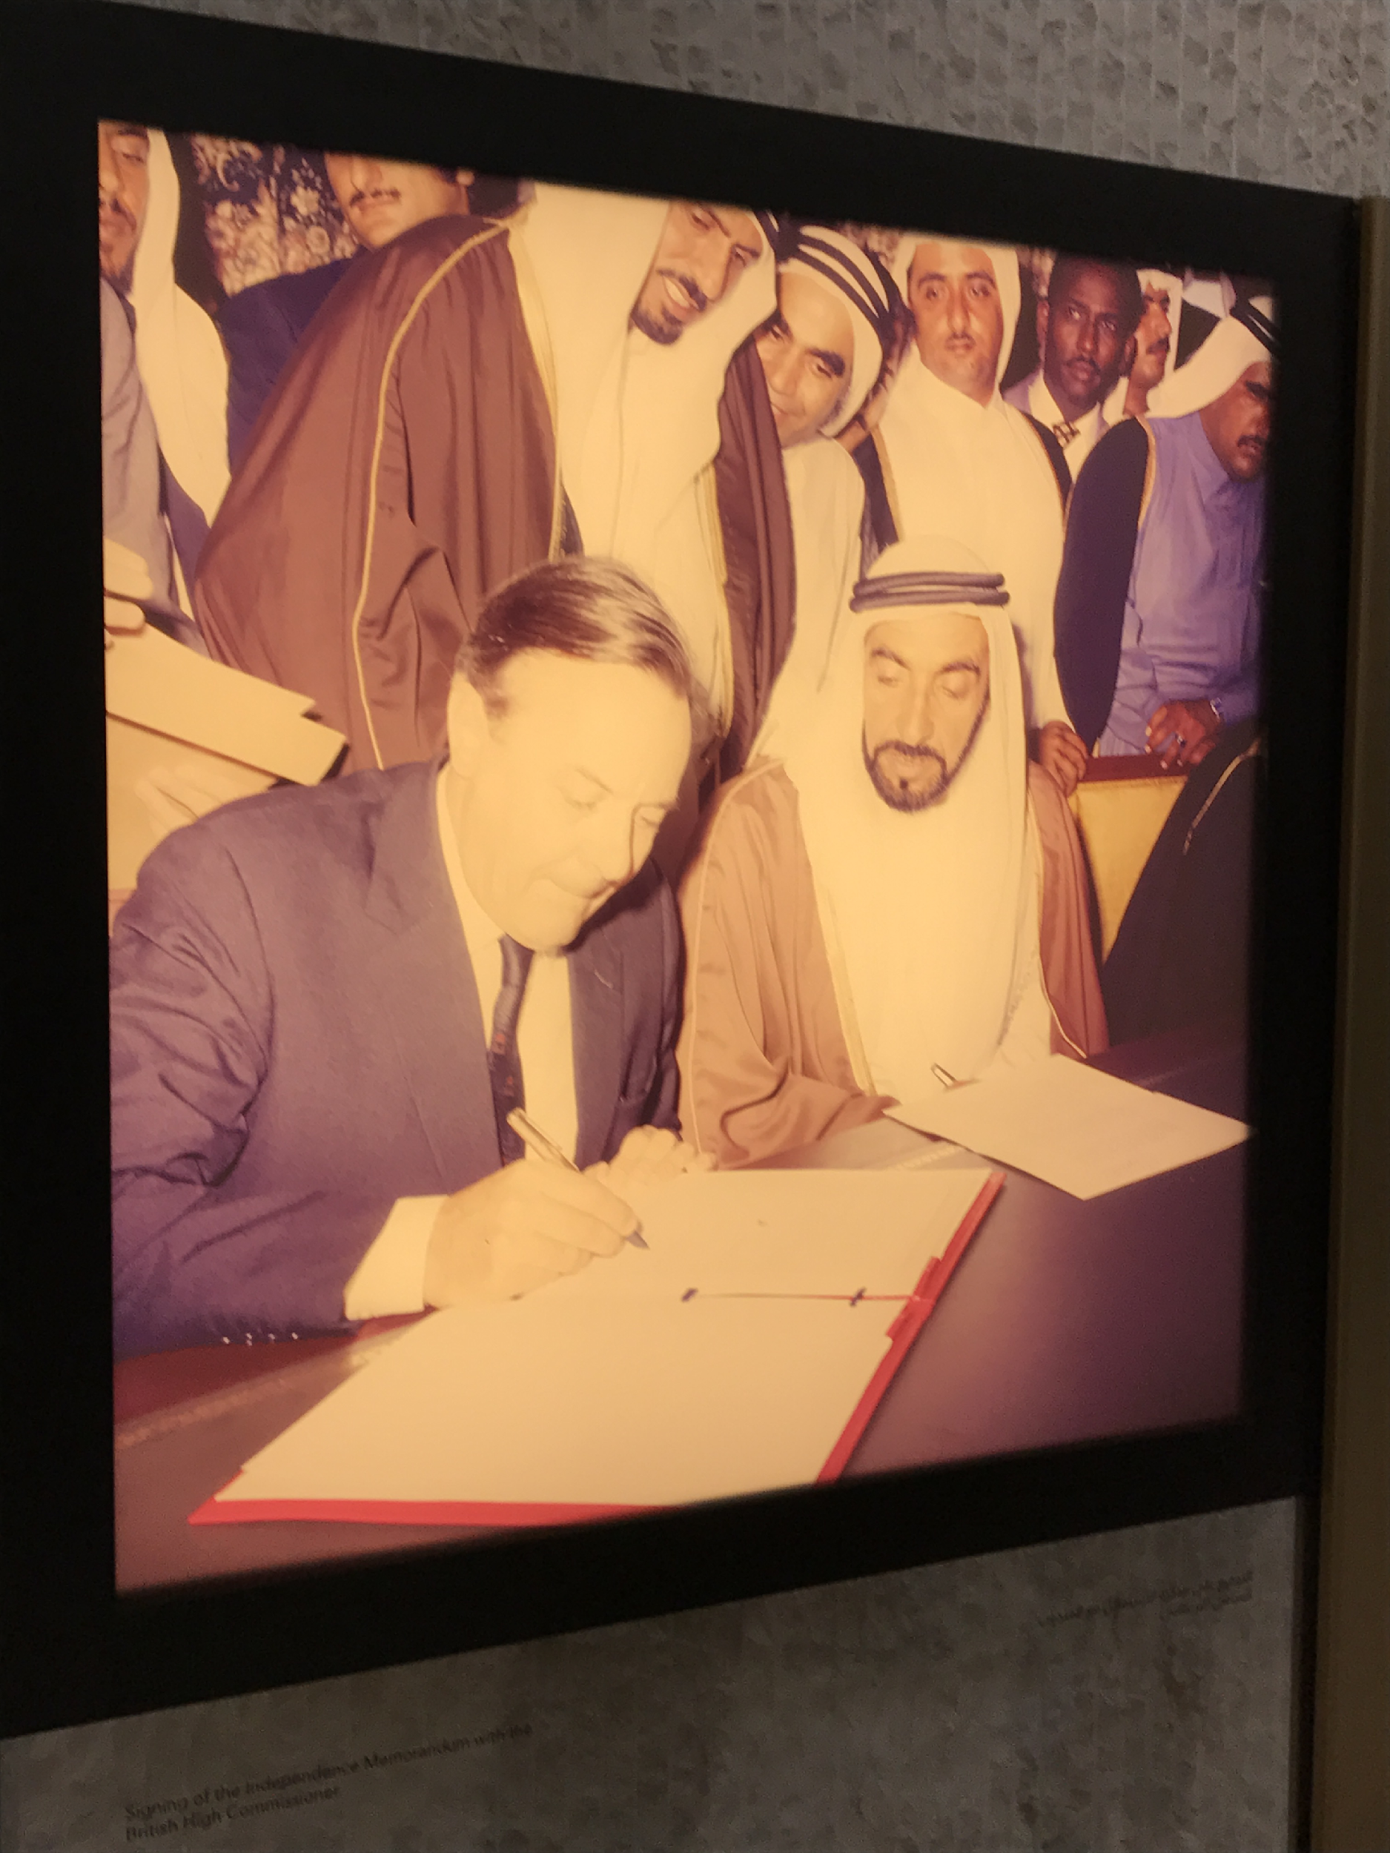
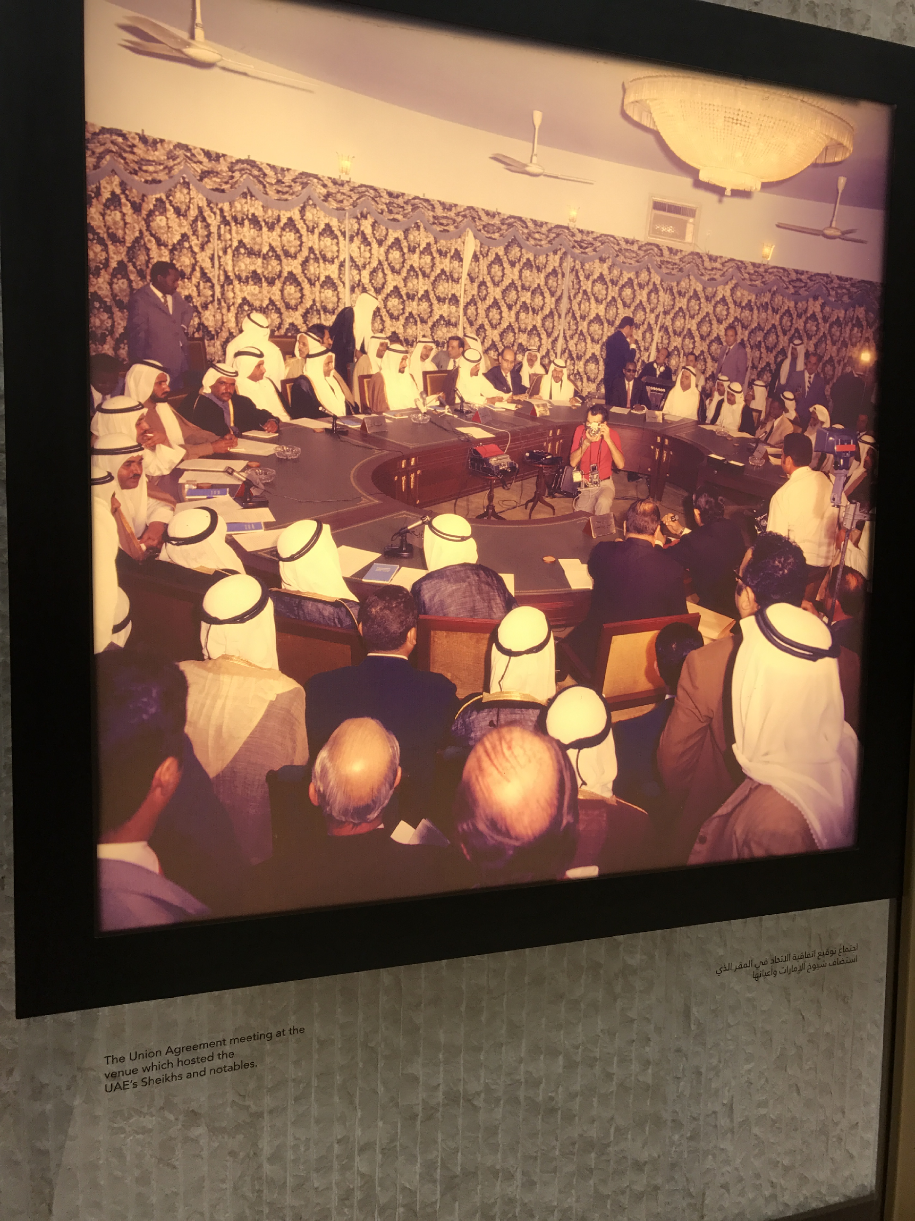
Picture caption: Signing of the Independence Memorandum with the British High Commissioner
Etihad Museum, 2017
Picture caption: The Union Agreement meeting
Etihad Museum, 2017

Slide 7
PART II: Students will compare and contrast key provisions in the U.S. Constitution with those in the constitution of the United Arab Emirates
Begin by asking the following questions:
What does it mean to be a citizen?
Is it the same everywhere – do all citizens have the same rights and responsibilities?”
Record key words from students answers on Smart Board/whiteboard, summarizing their thoughts when you are done taking answers.

Slide 8
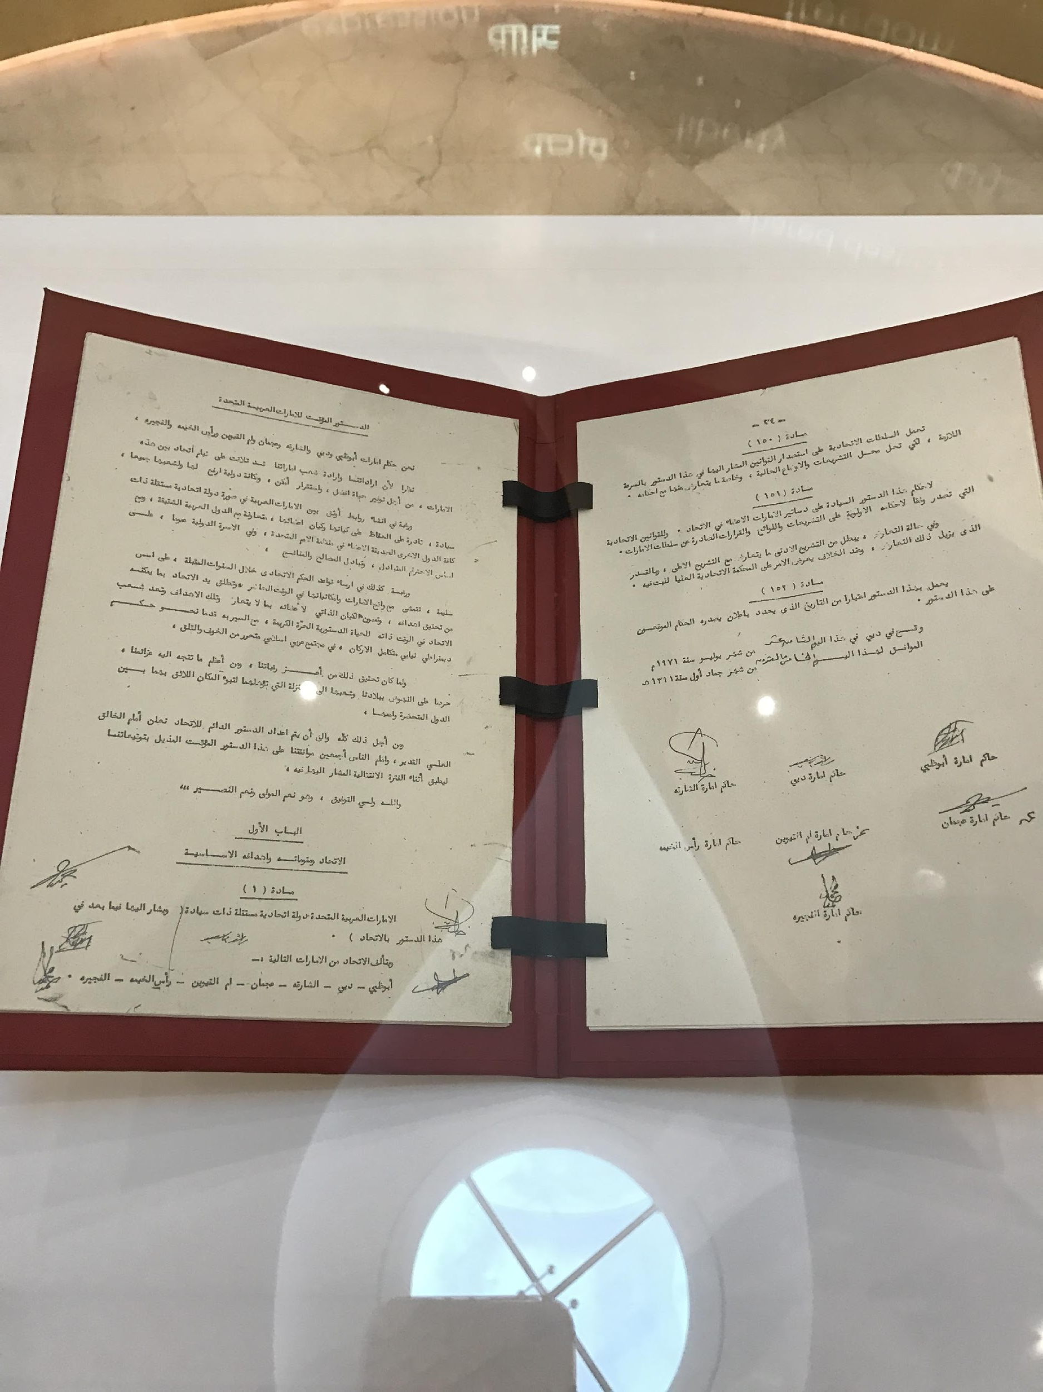
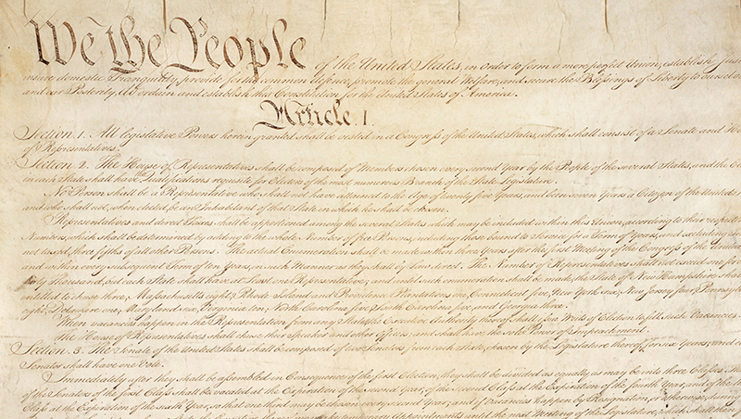
EXPLAIN: A CONSTITUTION…
Tells what a country’s values are
Tells how a country’s government operates
Tells what rights and responsibilities a country’s citizens have
Constitution of the United Arab Emirates.
Pictures from Miss Bowman’s visit to the Etihad Museum, 2017
U.S Constitution
https://www.whitehouse.gov/1600/constitution

Slide 9
FREEDOM OF SPEECH
The United States Constitution says:
“Congress shall make no law…abridging the freedom of speech…”
The Constitution of the UAE says:
Article 30: Freedom of opinion/thought/conscience
Freedom to hold opinions and express them orally, in writing or by other means of expression shall be guaranteed within the limits of the law.
Do they enjoy the same amount of rights as the U.S. Constitution protects, more, less, or none at all?

Slide 10
FREEDOM OF PRESS
“Congress shall make no law…abridging the freedom.. of the press…”
The Constitution of the UAE says:
Article 31: Freedom of communication by means of the posts, telegraph or other means of communication and their secrecy shall be guaranteed in accordance with the law.
Do they enjoy the same amount of rights as the U.S. Constitution protects, more, less, or none at all?

Slide 11
FREEDOM OF RELIGION
“Congress shall make no law respecting an establishment of religion, or prohibiting the free exercise thereof…”
The Constitution of the UAE says:
Article 7: Islam shall be the official religion of the Union. The Islamic Shari’ah shall be a principal source or legislation in the Union. The official language of the Union shall be Arabic.
Article 32: The freedom to hold religious ceremonies in accordance with established custom shall be safeguarded, provided such ceremonies are consistent with public order and with public morals.
Do they enjoy the same amount of rights as the U.S. Constitution protects, more, less, or none at all?

Slide 12
EQUALITY UNDER THE LAW
“Congress shall make no law respecting an establishment of religion, or prohibiting the free exercise thereof…”
The Constitution of the UAE says:
Article 25: All persons shall be equal before the law. No discrimination shall be practised between citizens of the Union by reason of race, nationality, religious belief or social position.
Do they enjoy the same amount of rights as the U.S. Constitution protects, more, less, or none at all?

Slide 13
“WHAT HAVE THEY GOT THAT I (WE) AIN'T GOT?”
Should the United States amend its constitution to say what the United Arab Emirates’s constitution says?
Article 16: Society shall be responsible for protecting childhood and motherhood and shall protect minors and others unable to look after themselves for any reason, such as illness or incapacity or old age or forced unemployment. It shall be responsible for assisting them and enabling them to help themselves for their own benefit and that of society.
Article 17: Education shall be a primary means of social development. It shall be compulsory in its primary stage and free at all stages within the Union. The law shall prescribe the necessary plans for the propagation and spread of education at various levels and for the eradication of illiteracy.
Article 19: Medical protection and means of preventive treatment and treatment for diseases and epidemics shall be guaranteed by society for all citizens. Society shall promote the spread of hospitals, clinics and facilities for both general and special treatment.
Article 23: The natural resources and wealth in each Emirate shall be considered the public property of that Emirate. Society shall be responsible for the protection and proper exploitation of such natural resources and wealth for the benefit of the national economy.

Slide 14
ADDITIONAL READING
http://gulfnews.com/news/uae/society/six-leaders-and-how-they-helped-shape-uae-1.1937162
http://www.uaeinteract.com/docs/UAE_honours_its_founding_father_/56332.htm
http://www.hraljournal.com/Page/15%20Gouher%20Ahmed.pdf

Slide 15
BIBLIOGRAPHY
“Founders of the Union - The Official Portal of the UAE Government.” Founders of the Union - The Official Portal of the UAE Government, The Official Portal of the UAE Government, government.ae/en/about-the-uae/founders-of-the-union. Accessed 4 June 2017.
“History.” History | UAE Embassy in Washington, DC, www.uae-embassy.org/about-uae/history. Accessed 4 June 2017.
“The Constitution.” The White House, The United States Government, 8 Mar. 2017, www.whitehouse.gov/1600/constitution. Accessed 4 June 2017.
“Constitute Project.” SpringerReference, 6 June 2017, pp. 1–38., https://www.constituteproject.org/constitution/United_Arab_Emirates_2004.pdf. Accessed 8 June 2017.
“Wikimedia Commons.” Wikimedia Commons, Google, https://www.google.com/search?hl=en&site=imghp&tbm=isch&source=hp&biw=1366&bih=638&q=constitution al+convention+1787&oq=constitutional+conv&gs_l=img.3.1.0l10.472.2473.0.4108.19.12.0.0.0.0.330.1623.0j5 j2j1.8.0....0...1.1.64.img..11.8.1621.mpdSPo5i3bw#hl=en&tbs=sur:fc&tbm=isch&q=uae+flag+small&imgrc=eFBt eNBkPtf6mM. Accessed 8 June 2017.

