Slide 1
AP Human Geography
Exploration and Explanation!

Slide 2
United Arab Emirates

Slide 3
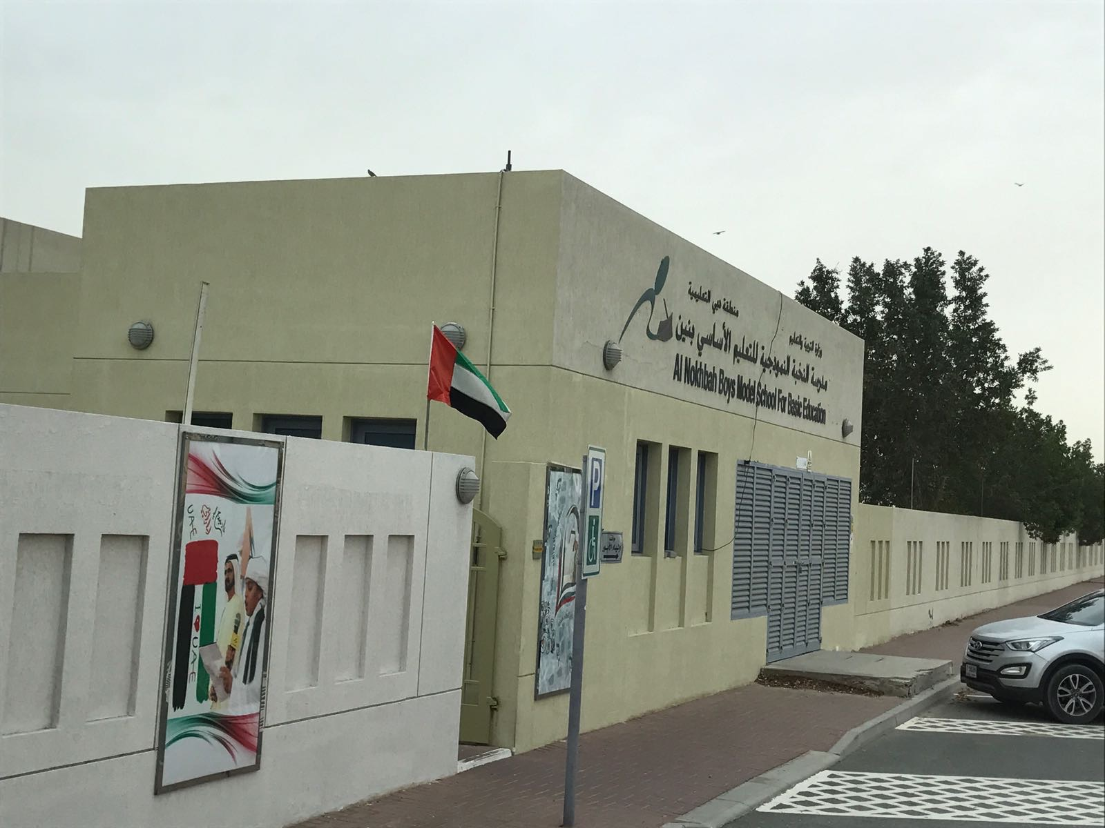
Al Nookbah School

Slide 4
UAE Space Agency

Slide 5
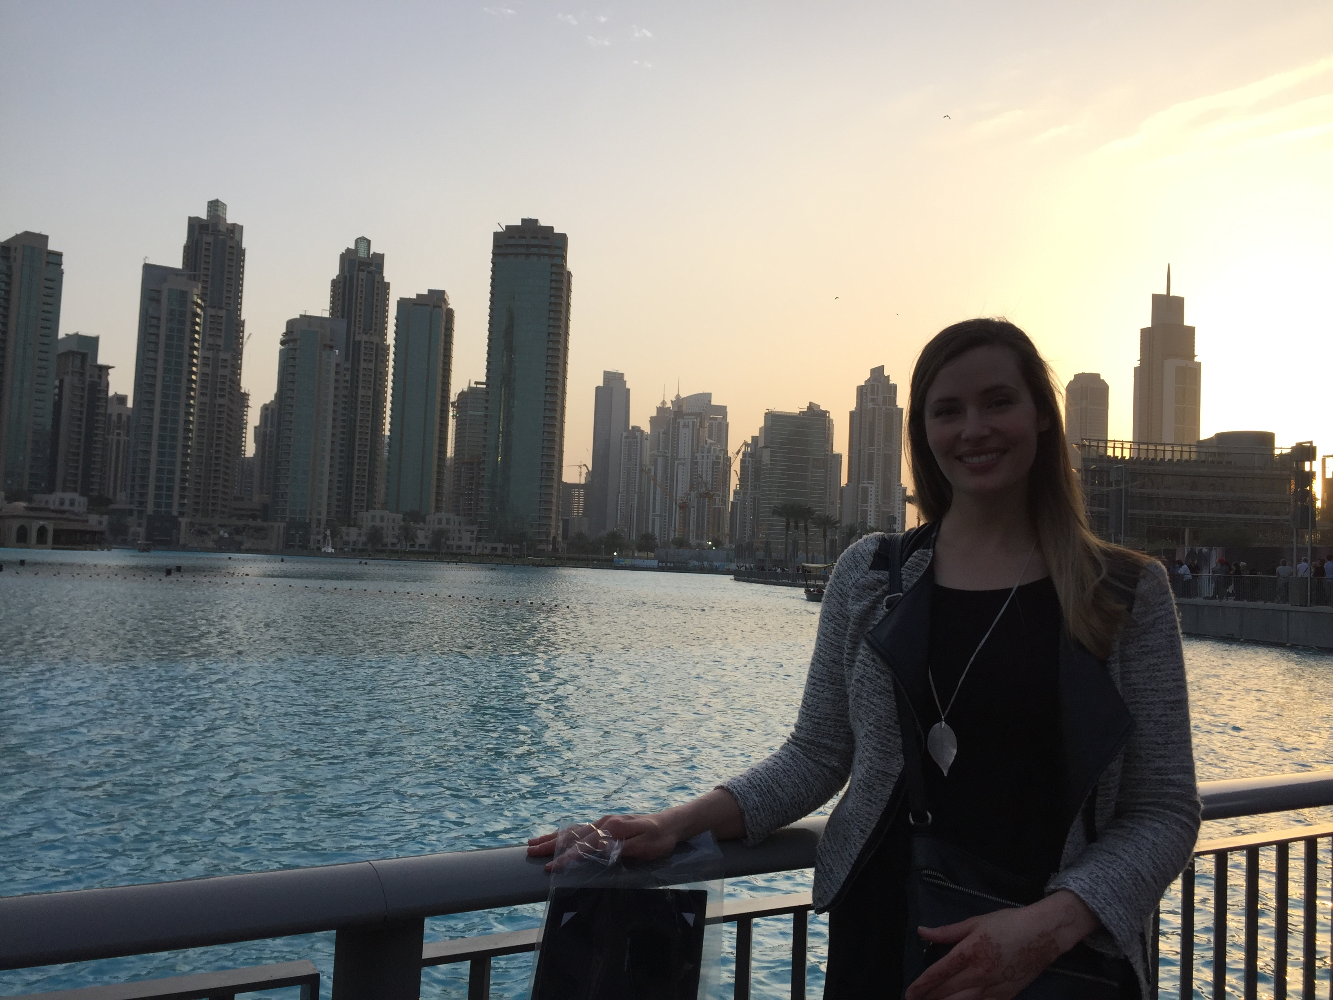
Dubai

Slide 6
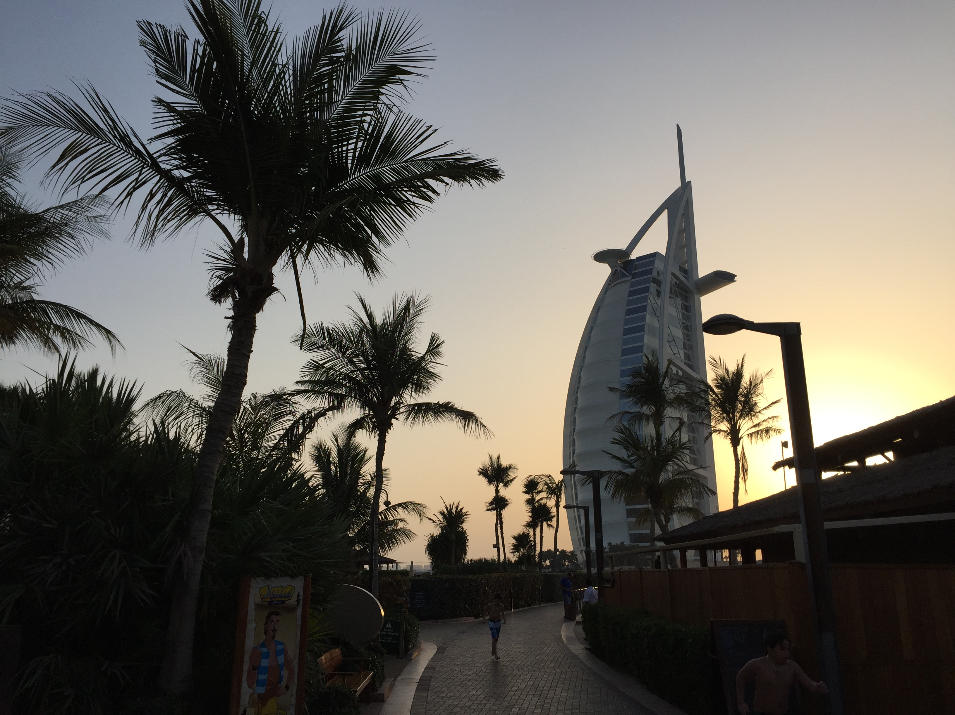
Dubai and Development

Slide 7
Flying Home

