Slide 1
Competitive long-term financing of Norwegian exports
Norwegian Finance Breakfast –
Dallas Federal Reserve,
April 18, 2012

Slide 2
Eksportfinans is managing a new state-funded export financing scheme
Eksportfinans is currently managing the Norwegian export financing scheme on behalf of the Norwegian government, as represented by the Ministry of Trade and Industry (MTI). MTI is the lender of record
Loans qualifying under the OECD Arrangement for Export Credits, so-called CIRR-qualifying loans, are offered as before
Eksportfinans will negotiate loan agreements and other loan documentation, which will be approved by MTI prior to execution
A new state entity for export financing will be operational as of 1 July 2012

Slide 3
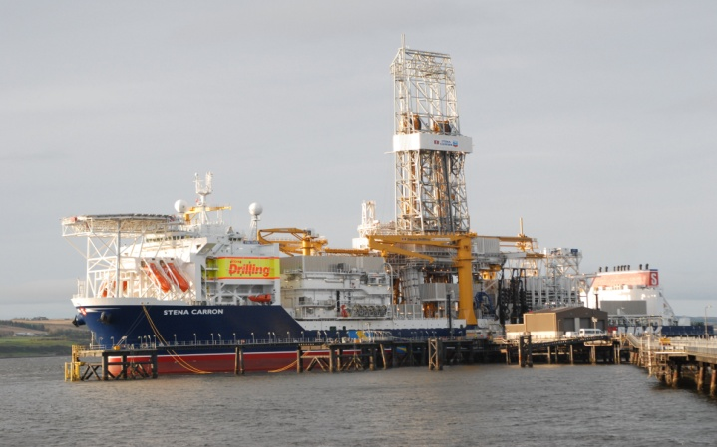
50 years of experience serving the Norwegian export industry

Slide 4
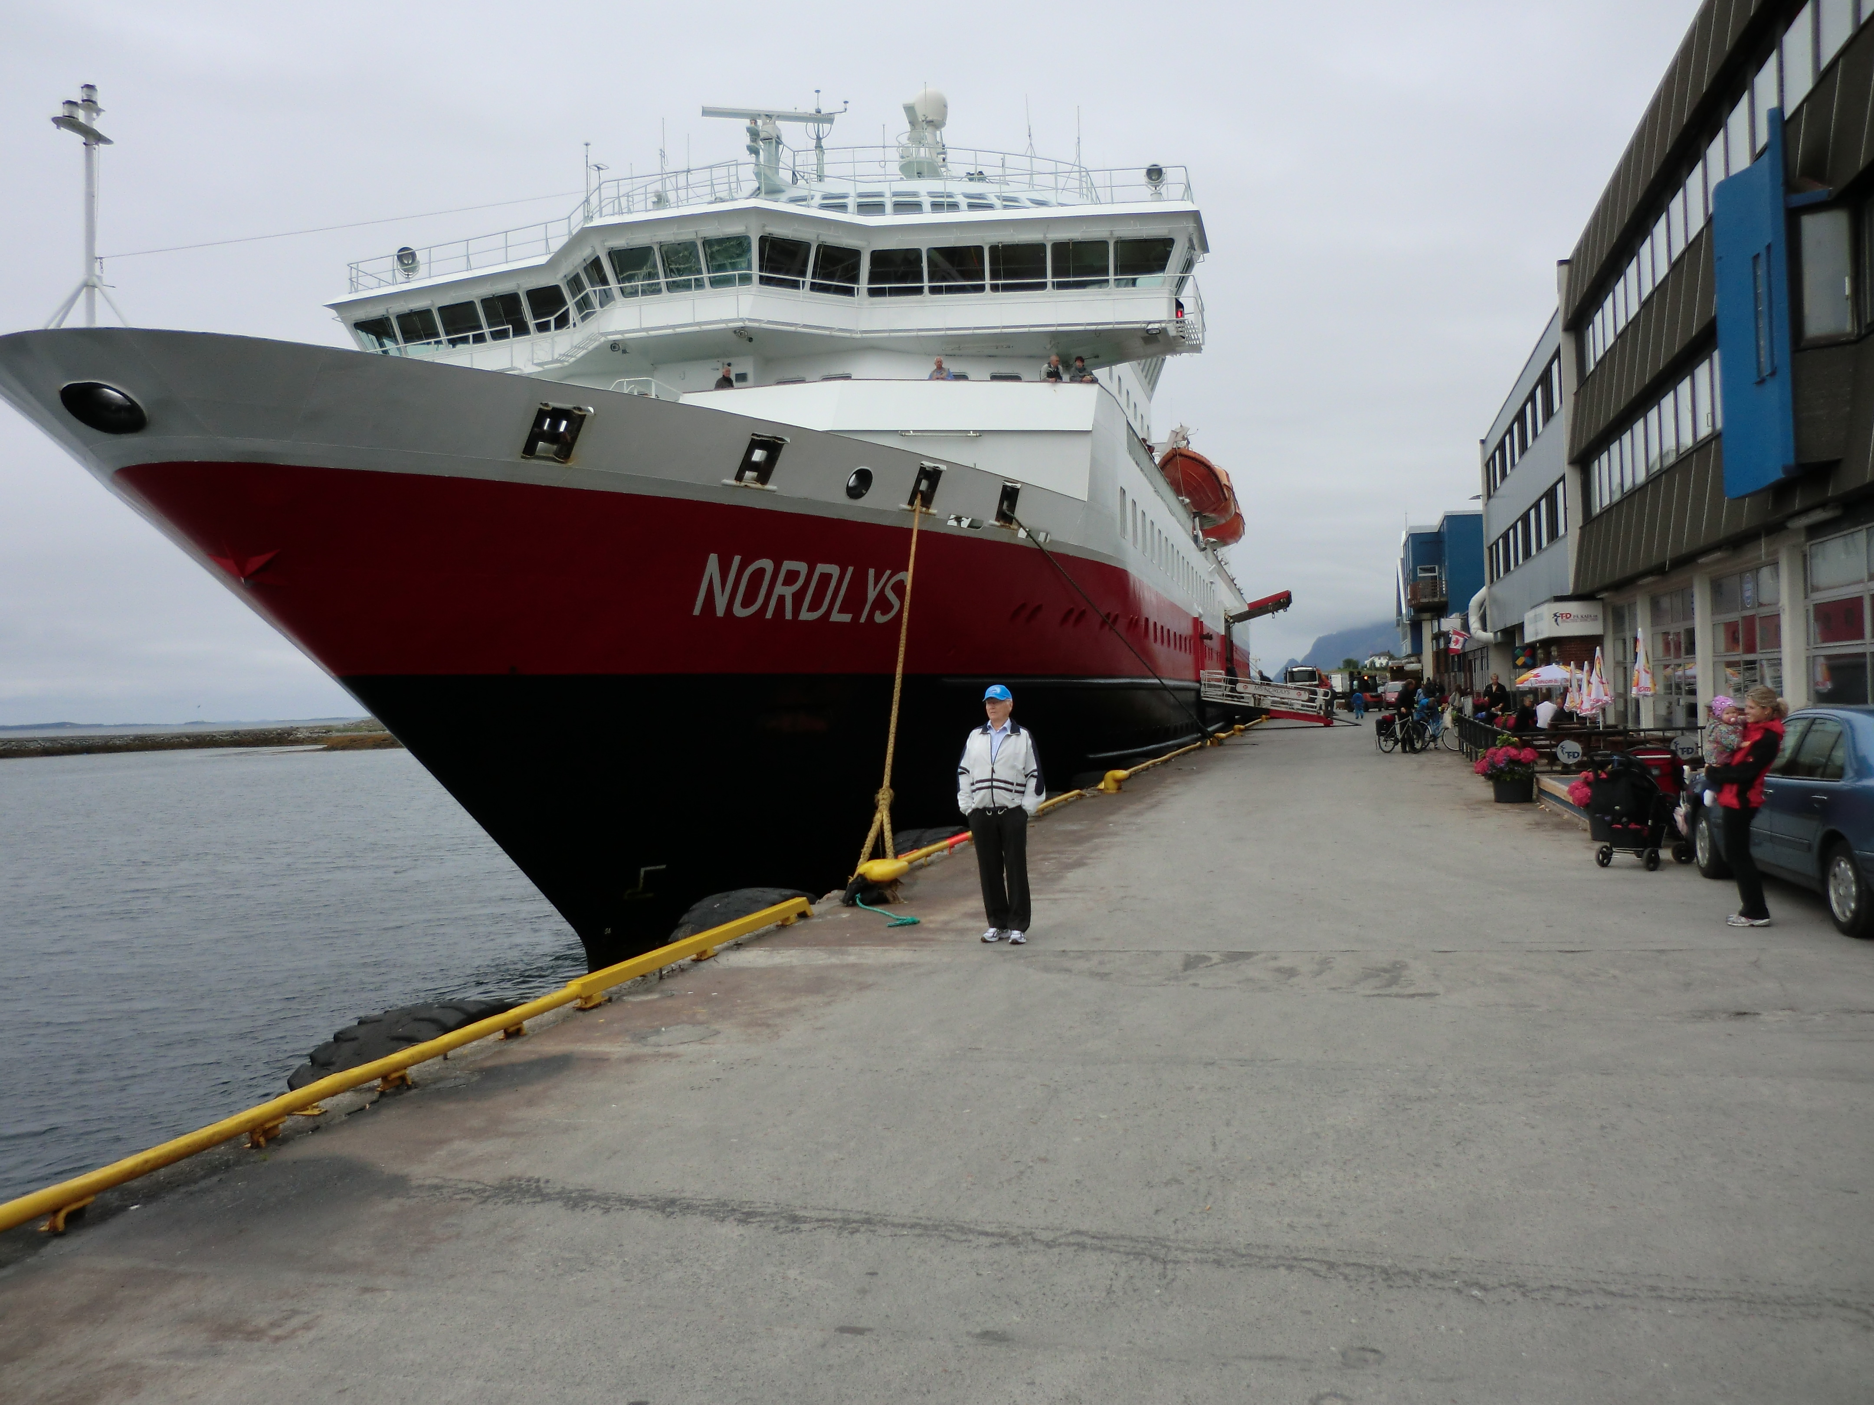
Competitive long-term debt financing of
Norwegian exports…
… on terms in accordance with OECD’s framework for export financing and regulations set by Norwegian authorities
- The exporter must be a company based in Norway or a company abroad under direct Norwegian majority control
Up to 85 % of the export contract amount may be financed
Norwegian content must account for at least 30 % of the contract amount
Loan repayment is generally from 2 to 8.5 years. Up to 18 years for renewable energy projects
Drawdown of loan in accordance with delivery schedule
Guarantee(s) from GIEK and/or acceptable financial institution required

Slide 5
Prospective borrowers are offered an attractive choice between two interest rate alternatives
Officially-supported Commercial Interest Reference Rates (CIRR)
Market term interest rates
Provides borrowers with a fixed interest rate indication before contract award. In effect sets an interest rate ceiling
All OECD currencies available
OECD adjusts rate levels on the 14th of every month; publicly available on www.oecd.org
Reference rate (such as LIBOR or EURIBOR) + fixed margin
Most convertible currencies available
Priced on commercial terms according to prevailing market conditions
Must be in accordance with ESA’s reference interest rate guidelines
Borrowers’ choice between the two interest rate options may remain open until shortly before final drawdown of the loan

Slide 6
An attractive interest rate option: CIRR rates currently at historically low levels
Pre-contract CIRR RATES April 15 –May 14, 2012
 | < 5 y | 5.5 – 8.5 y | 9-12 y | 18 y
USD | 1.71 | 2.22 | 2.86 | 3.57
EUR | 1.92 | 2.60 | 3.20 | 4.02
NOK | 2.89 | 2.89 | 2.89 | 3.92

Slide 7
April 17, 2012 Norwegian Supplier applies for financing. CIRR rate USD, 18y, at 3.57% (the ceiling rate)
Dec. 2014
Last drawdown and consolidation of the loan.
(Before final drawdown, the Borrower must decide whether to convert the interest rate to CIRR, if he has drawn the loan thus far on market terms.)
The loan’s repayment period is 18 years with fixed interest rate as per Outline in April 2012(3.57%)
November 12, 2012
The Buyer enters into contract with Norwegian Supplier
Dec.2013
Deliveries start, and the Borrower starts drawdown of loan on CIRR terms (or alternatively market- based terms)
Example: Contract between Norwegian Supplier and
Project Owner abroad is financed under the state-funded scheme

Slide 8
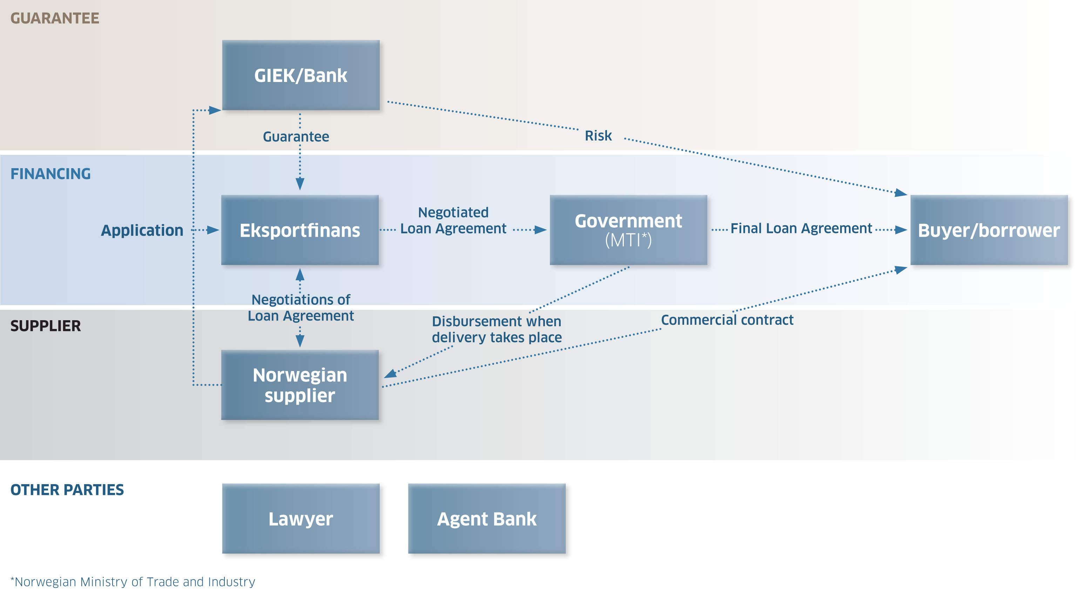
Parties involved in an export financing transaction

Slide 9
Norwegian content must account for at least 30 % of the contract value
VALUE ADDED
FINANCING
GUARANTEE STRUCTURE
MINIMUM 30 % NORWEGIAN CONTENT
MINIMUM 15 %
EQUITY
85 %
STATE-FUNDED
FINANCING
70-90 %
GIEK *
GUARANTEE
10-30 %
BANK
GUARANTEE
CONTRACT
UP TO 70 % NON-NORWEGIAN CONTENT
LOCAL CONTENT MAX. 30 % OF SUM OF NORWEGIAN AND THIRD COUNTRY CONTENT
Deliveries from companies based in Norway or companies abroad under direct Norwegian majority control generally qualify as Norwegian content

Slide 10
The application process -Exporter or prospective borrower must apply for financing before contract award

Slide 11
Thanks a lot for your kind attention !

